Slide 1

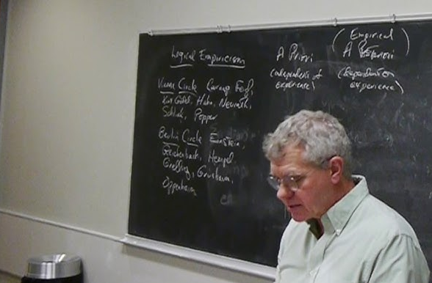
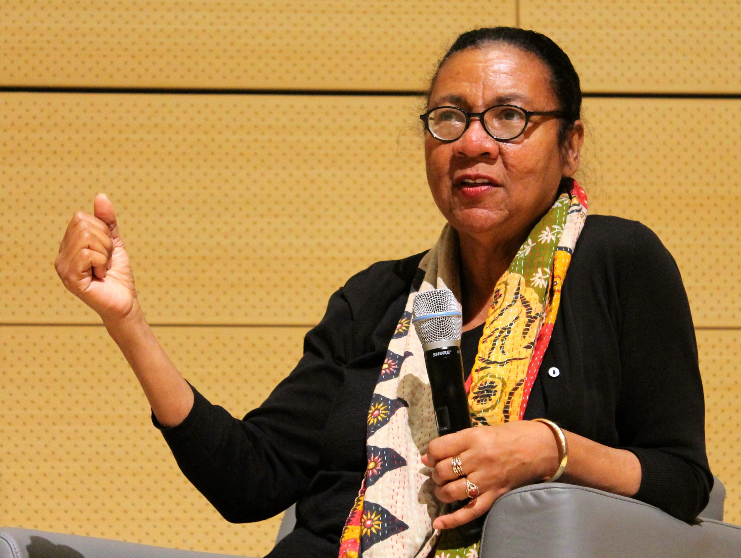
Explanation and Understanding in Science
TA: Luka Vinck 24 September 2026
Philosophy of Science Tutorial 4

Slide 2
Project
Questions?

Slide 3

Today’s Plan
Godfrey-Smith: Explanation
Break
De Regt and Dieks: Understanding

Slide 4
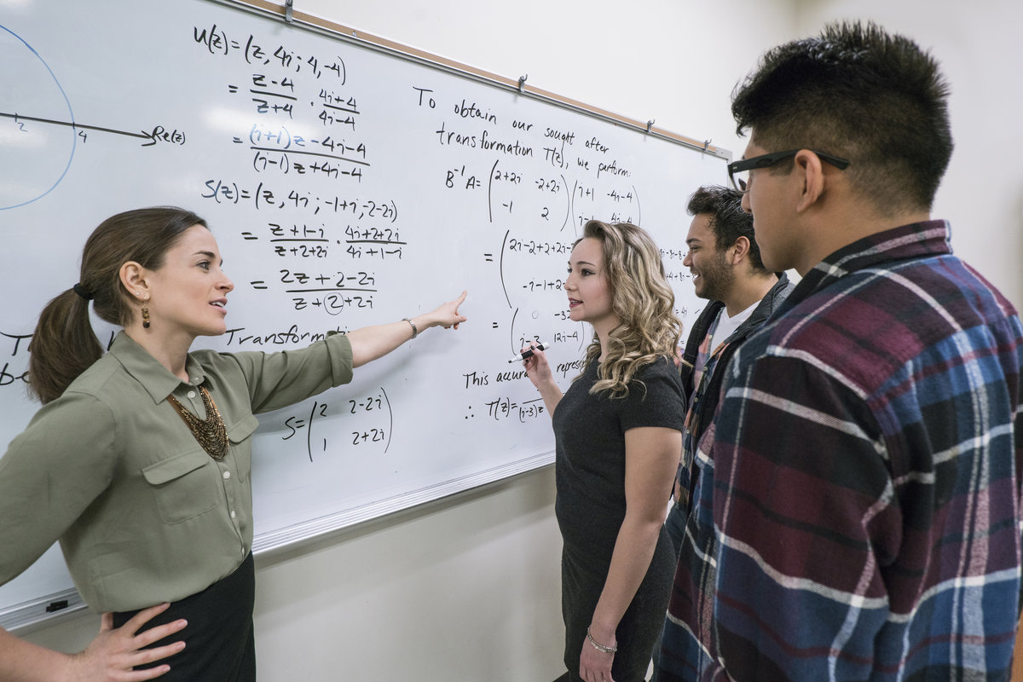
Godfrey-Smith - Explanation
Question
What is the importance of the notion of explanation for philosophy of science?
And why is it problematic?

Slide 5
Godfrey-Smith - Explanation
Discuss in groups
What is the logical empiricists’ theory of explanation?
(known as the ‘covering law’ or D-N model)
What is the main challenge for this theory?

Slide 6
Godfrey-Smith - Explanation
Question
What are the two main alternative ideas on explanation?
(and their challenges)?

Slide 7
Godfrey-Smith - Explanation
Discuss in groups
Which notion of explanation do you find most convincing, or do you agree
with Godfrey-Smiths pluralist/contextualist view of explanation?
Is explanation a crucial notion for the inner workings of science, or rather
something external to it?
(cf. van Fraassen’s pragmatic account of explanation)

Slide 8
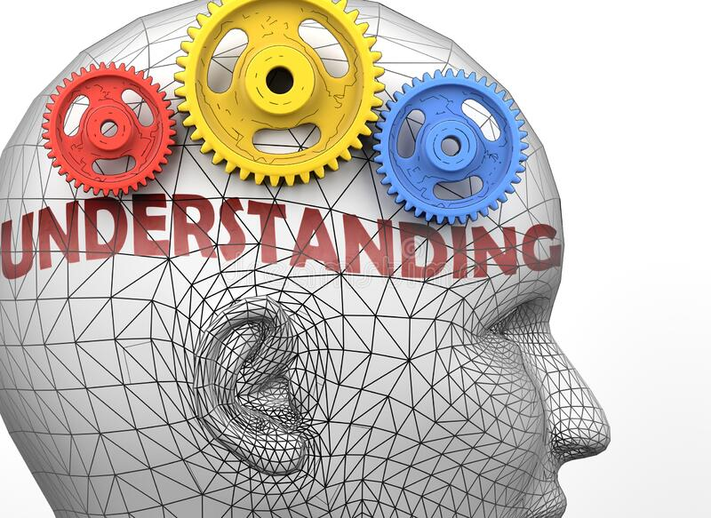
Scientific
Break
After the break:

Slide 9

De Regt and Dieks: Scientific Understanding
Question
What is the relation between explanation and understanding?
Goal: to develop a general characteristic of scientific understanding that
can account for the variation in actual historical practice
Understanding unifying role in pluralist view of explanation
Pragmatic: context-dependent

Slide 10
De Regt and Dieks: Scientific Understanding
“Contra Hempel, van Fraassen, and Trout, we hold that the pragmatic nature
of understanding is not inconsistent with it being epistemically relevant.”(p.141)”
Discuss in groups
What is the epistemic relevance of understanding in science according to De
Regt and Dieks, and do you agree?
What are the conditions for scientific understanding of a theory?

Slide 11
De Regt and Dieks: Scientific Understanding
Criterion for Understanding Phenomena (CUP): an intelligible theory
Criterion for Intelligibility of a Theory (CIT):
A theory T is intelligible for a scientist in a certain context if they can recognise qualitatively characteristic consequences of T without performing exact calculations
Question
Does this reduce understanding (intelligibility) to a subjective affair, why yes/no?

Slide 12
De Regt and Dieks: Scientific Understanding
Discuss in groups
Can you think of different kinds of conceptual toolkits that help scientists
with qualitative reasoning? At what level do these operate?

Slide 13
De Regt and Dieks: Scientific Understanding
De Regt and Dieks argue that understanding should be seen as an ‘additional epistemic
aim of science’ (p.153)
Question
Do you think De Regt and Dieks’ account of understanding is convincing?

Slide 14
Next week: Scientific Realism with Matteo
Friday 25 September (tomorrow) deadline Project Proposal

